Slide 1
HISTORY GE-IV RELIGION AND RELIGIOSITY

Slide 2
COURSE OBJECTIVES
The course intends to familiarise the students with various religious traditions from the Vedic to the modern times.
It helps develop a critical understanding of various concepts on religion and religiosity, with the help of examples from the past and its validity in the present context.
The paper seeks to investigate concepts such as, Vedic traditions, Puranic Hinduism, renunciatory traditions, Sufism, Secularism, conversion and identities among many others.

Slide 3
COURSE OBJECTIVES
It also discuses the growing plurality of Indian society during the 19th and the early 20th centuries and how they came to be accommodated into a shared and cosmopolitan space like Bombay.
The course also intends to critically engage the students with the most contested topics like communalism and the construction of Hindu nationalism, from colonial times to the present day.
It seeks to develop a holistic and historical understanding of various topics pertaining to religion and religiosity.

Slide 4
SOURCES & PEDAGOGICAL TOOLS
The course uses both primary and secondary reading material.
Documentaries, photographs, maps and other ICT mediums will be used for the relevant parts of the course.

Slide 5
THEMES

Slide 6
Themes
Introduction to Religion and Religiosity
From Vedic traditions to Puranic Hinduism
The renunciatory traditions-Buddhism and Jainism
Religious institutions, patronage; pilgrimage; patronage in early India
Muslim communities of belief : textual and mystical practices.

Slide 7
Themes
The making of medieval religious spaces (Vrindavan in the 16th & 17th centuries)
Conversions and identities
Plurality and shared spaces (19th and early 20th century)
Identity and politics of religion (late 19th and 20th century)
Secularism and the modern nation state

Slide 8
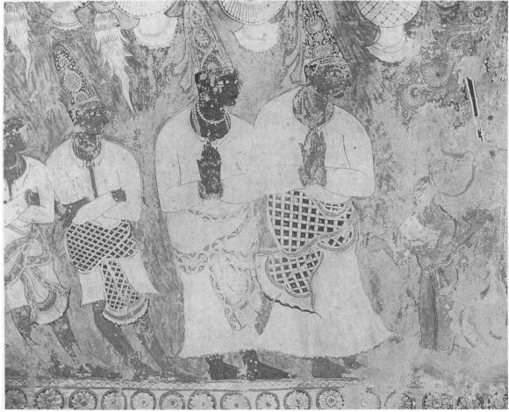
Vijayanagara courtiers worshipping deities. Ceiling painting in the natya mandapa, Virabhadraswamy temple, Lepakshi (Anantapur dist., AP)

Slide 9
THANK YOU
For further queries, please contact
jhansi.rangu@mirandahouse.ac.in

